Slide 1


Measure of Influence in Linear Regression
Regression: y=Xβ + e => β=(X’X)⁻¹X’y
h_{i}
DFFITS

Slide 2
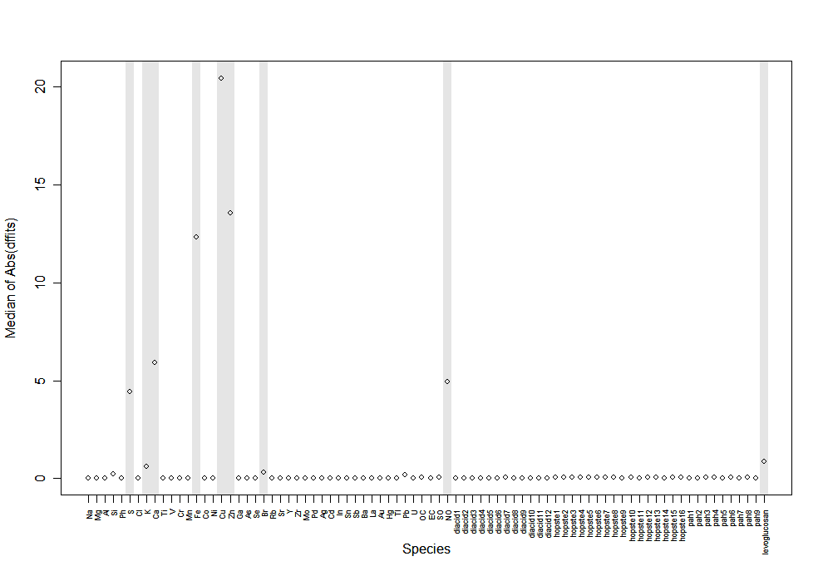
Influence for full 82 species (unweighted)

Slide 3
